Slide 1
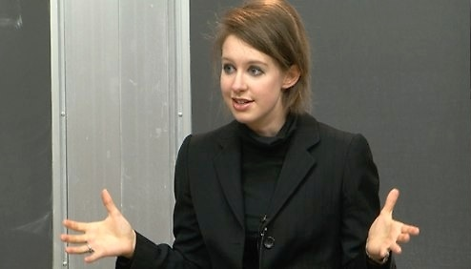
2015 IMBA
Self-confidence and Self-motivation
International MBA
Dr John E Coulter 壮歌德博士

Slide 2
Elizabeth Holmes (born 1984) is an American entrepreneur. She is the CEO of a blood test company, which she founded in 2003 at age 19 while she was at Stanford University. The company was originally based on her invention and patent for a way to run 30 common lab tests, on blood and was valued at nearly $10 billion. She is the youngest self-made female billionaire on the 2014 Forbes list, with an estimated net worth of $4.6 billion.

Slide 3
As a child, she read the biography of her great-great-grandfather Christian R. Holmes, who was a surgeon, engineer, inventor, and a decorated World War 1 veteran.
He was born in Denmark in 1857 and was the dean of the a university where a hospital is named after him.
The career of her ancestor inspired Elizabeth to take up medicine, but she soon found that she had a fear of needles.

Slide 4
MOTIVATION
Holmes doesn't own a TV and states she works every day from the time she wakes up until she goes to sleep. She says that "What matters is how well we do in trying to make people's lives better. That's why I'm doing this. That's why I work the way that I work. And that's why I love what I'm doing so much."

Slide 5
Market capital
work land
external factor price of gasoline
dream Yankee
Bad people sophisticated people

Slide 6
Self confidence
includes public speaking
So lets practice introducing each other (like in the first lesson)

Slide 7
Stand up
Compose yourself
(hands,
shoulders,
deep breath,
look around,
Smile,
Speak slowly and clearly)

Slide 8
The person on the left finds out about the partner on the right and then:
“This is John Coulter.
He said to call him John.
He is from Australia.”

Slide 9
I would like to introduce my classmate.
She said to call her Vanessa
She is from South China, Guangdong
She has worked for a seed company for 3 years.

Slide 10
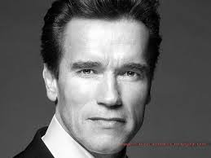
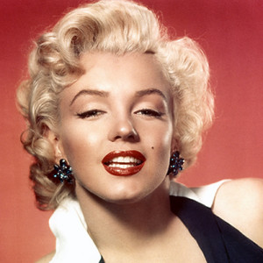
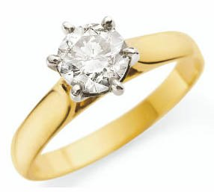
Who is he?
I don’t know him
His name is Arnold
Schwarzenegger
How do you spell his
surname?
Her name is Marilyn Monroe.
She was a movie idol.
President Kennedy had a affair with her.
This ring was hers

Slide 11
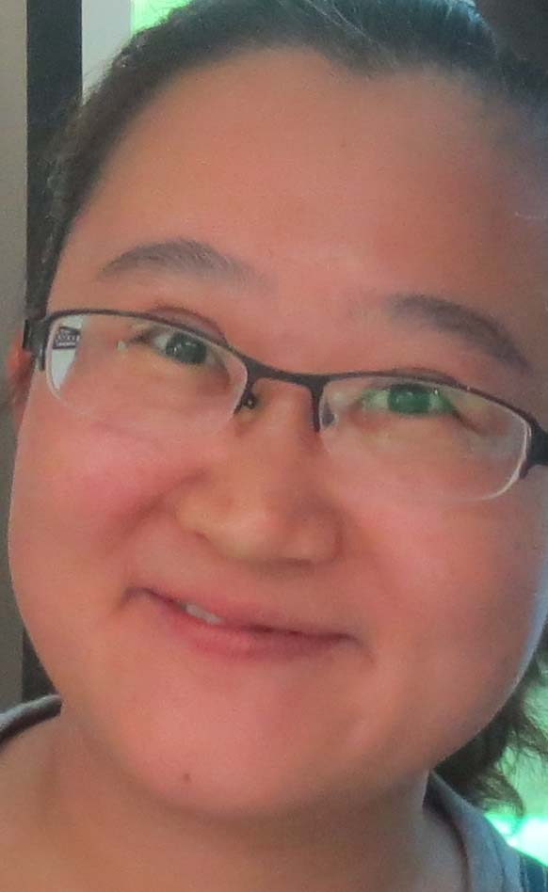
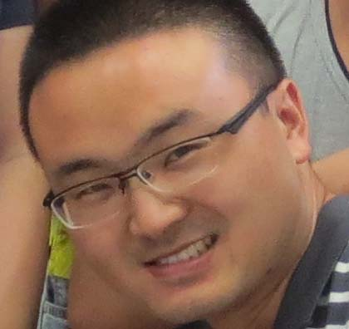
Think of the person.
Think of the image.
Boy or girl

Slide 12
He She
Him Her
His Her
He is new here. I don’t know him. His name is Bill
She came last week. I met her on the bus. Her name is Jane.
He will come tonight. She wont come tonight.

Slide 13
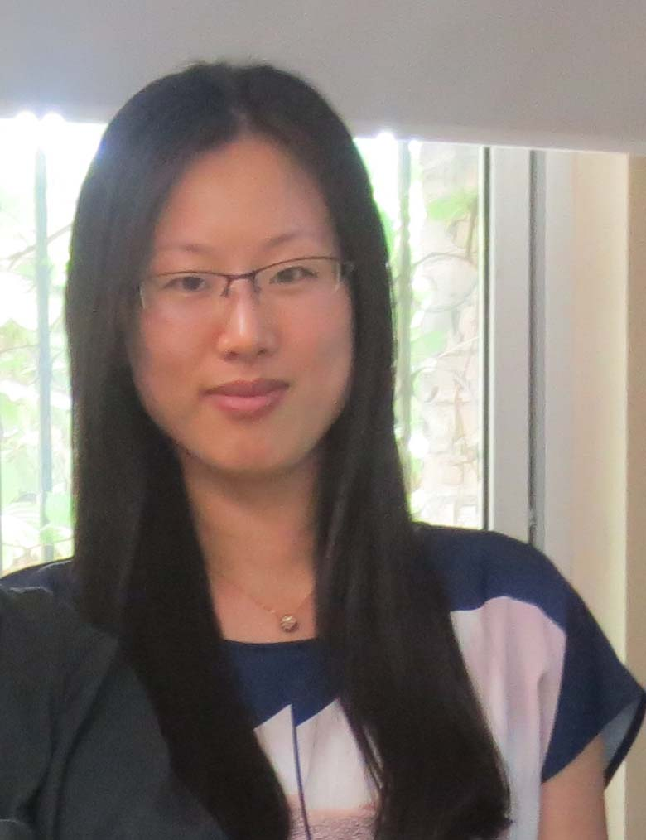
Make up a sentence

Slide 14
Make up a sentence
I know her. Her name is Georgia. She has long hair.
She is here today.

Slide 15
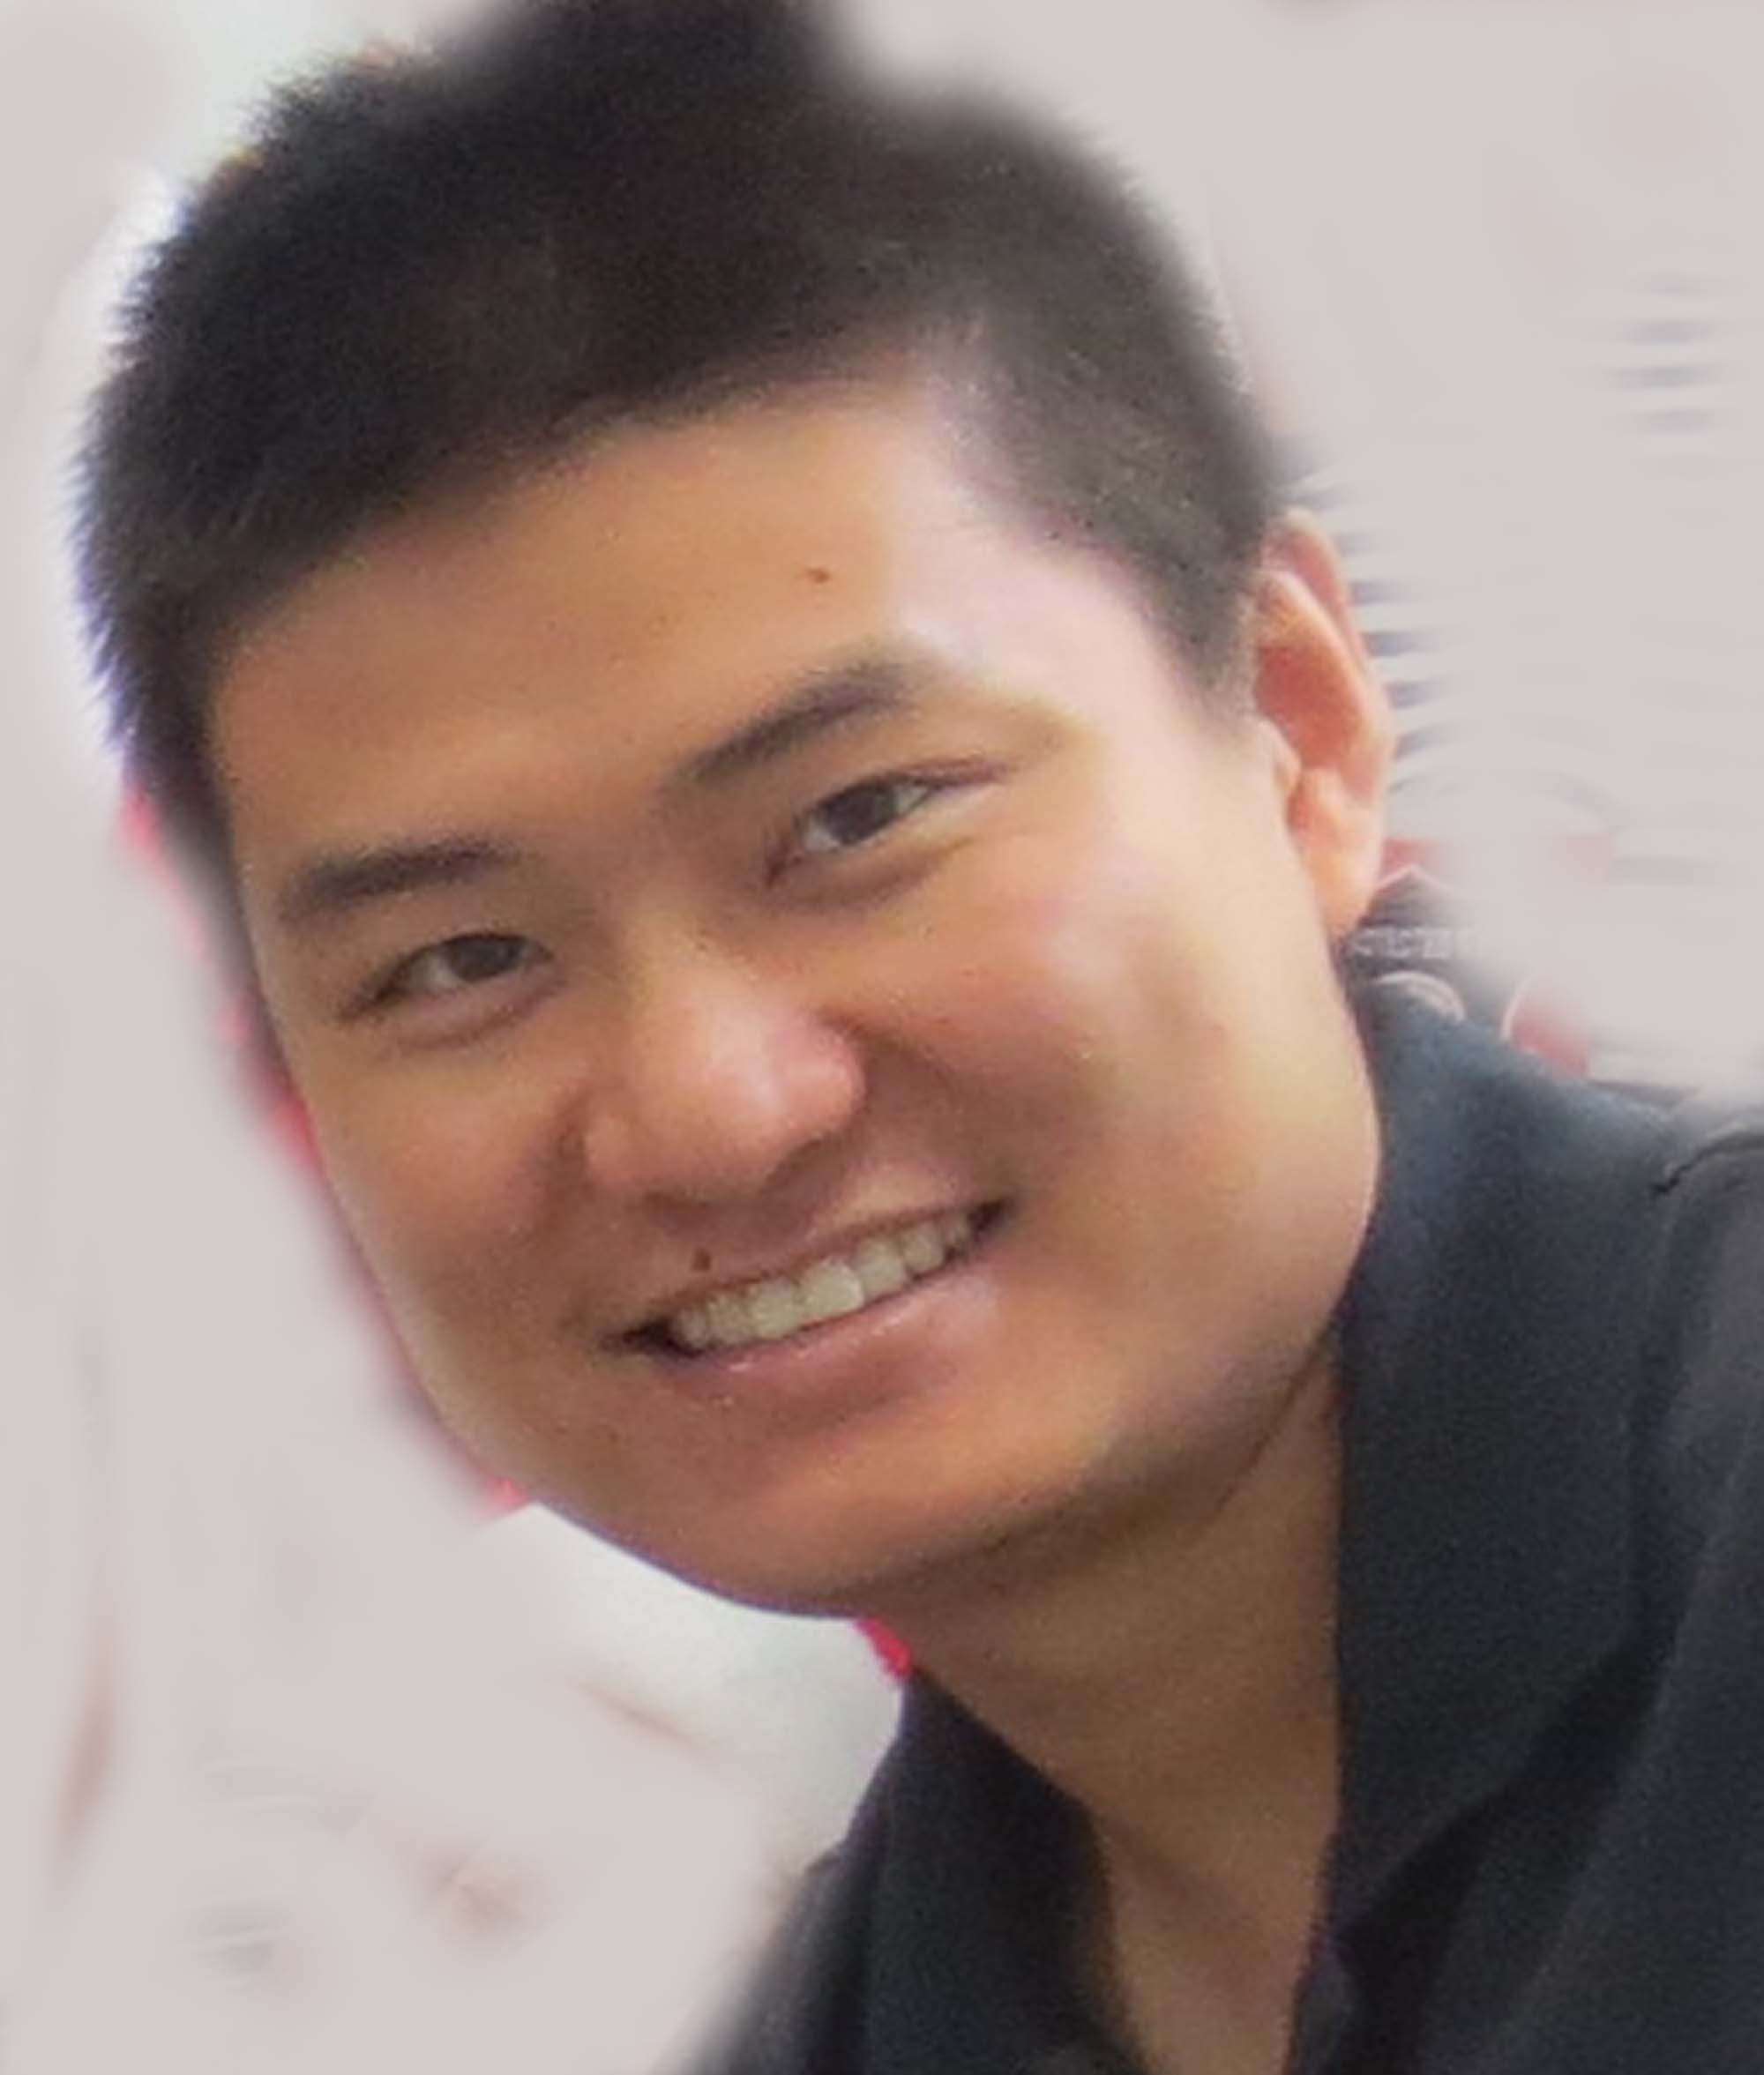
Make up a sentence

Slide 16
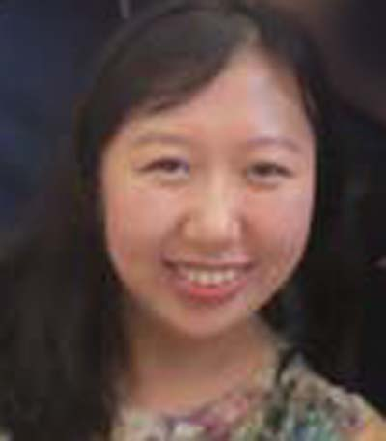
Make up a sentence

Slide 17
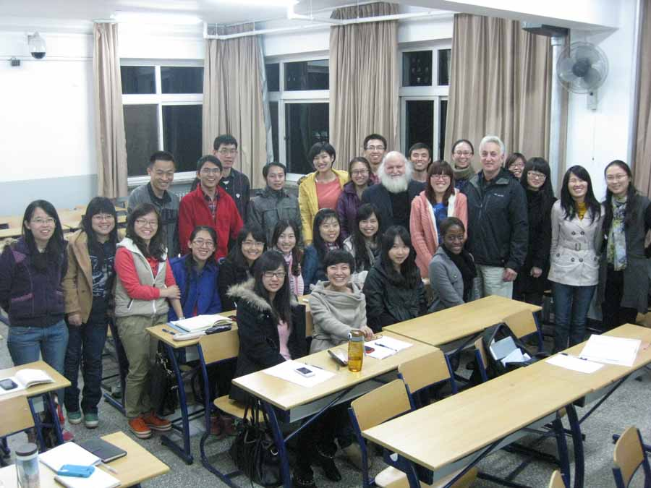

Slide 18
What is Motivation?
Motivation is what pushes us to achieve our goals, feel more fulfilled and improve overall quality of life.

Slide 19
The suffering of his impoverished parents motivated him to build a successful business
他贫穷的父母所遭受的痛苦激励着他在事业上获得了成功
父母饱受贫穷困扰的现实，激励着他创办企业，获得成功。

Slide 20
The story of Gandhi motivated me
甘地的故事激励着我。

Slide 21
.
After I visited California's Silicon Valley I was motivated to start a high-tech agribusiness company
参观硅谷的经历激励着我创建一个高科技农业公司
参观加州硅谷后，我有了建立一个高科技农业公司的念头。

Slide 22
Self-motivation is,
in its simplest form,
the force that drives you to do things.
Self-motivation is far from being a simple topic; there are many books, webpages and articles that attempt to explain self-motivation and some top academics have dedicated their life’s work to trying to understand, model and develop motivation theory.

Slide 23
Personal drive to achieve, the desire to improve or to meet certain standards;
Commitment to personal or organisational goals;
Initiative, which he defined as ‘readiness to act on opportunities’; and
Optimism, the ability to keep going and pursue goals in the face of setbacks.

Slide 24
There are many advantages to self-motivation.
People who are self-motivated, for example,
tend to be more organised,
have good time management skills and
more self-esteem and confidence.

Slide 25
What is your goal?
In life?
In your career?
The next 10 years
The next 5 years?
The next 12 months?

Slide 26
Motivation is
either a push away
Or
an attraction forward

Slide 27
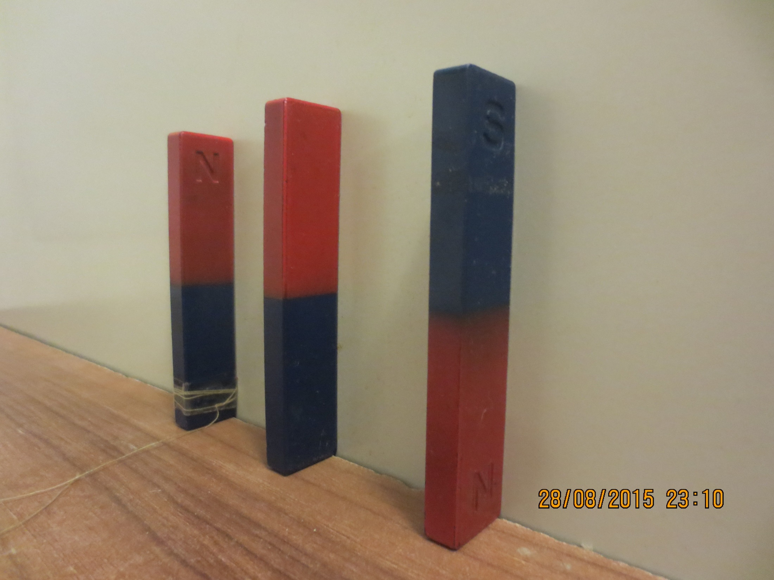
Motivated towards something
You
Attractive goal
Bad experience

Slide 28
Motivated towards something
You
Attractive goal
Bad experience

Slide 29
Motivated towards something
You
Attractive goal
Bad experience

Slide 30
Motivated towards something
You
Attractive goal
Bad experience
War,
Bad business
Bankrupt
Cheated
Wrong love
Accident
Natural disaster

Slide 31
Motivated towards something
You
Attractive goal
Bad experience
Inspiring person
A book
A visit
A movie
A dream
Advertisement?

Slide 32
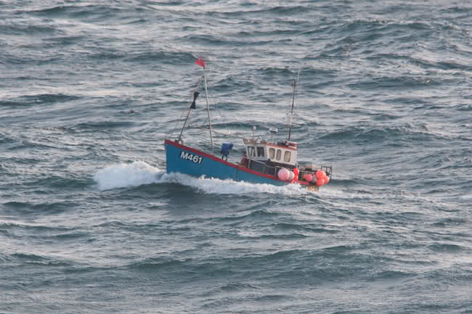
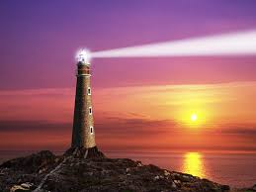
A goal. A beacon. An aim in life

Slide 33
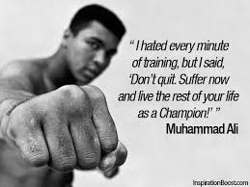

Slide 34
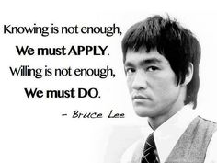

Slide 35
Last week,
Critical Thinking.
Write down short notes on an example in your life where critical thinking was needed.
Succeed or failed?

Slide 36
Applying for a job
Self-motivation and drive to succeed: Ideally, you should use an example where you decided to do something independently (usually outside academia). This could include a whole range of things, such as fundraising work, self-driven learning, or sporting achievements.

Slide 37
Self motivation
Self starter

Slide 38
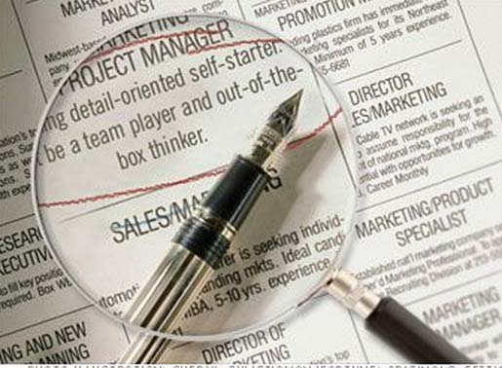

Slide 40
What is Your Motive?
Fundamental to self-motivation is understanding what motivates you to do things.
This may sound straightforward but sometimes your motivation is hidden from your consciousness – your own personal hidden agenda. Your motivation may well change from hour-to-hour, day-to-day and through life. As this happens your needs, wants and goals change and evolve.

Slide 41
Skills Involved in Self-Motivation
There are a number of skills involved in self-motivation.

Slide 42
Setting high but realistic goals.
Taking the right level of risk.
Seeking constant feedback to work out how to improve.
Being committed to personal or organisational goals and going the ‘extra mile’ to achieve them.
Actively seeking out opportunities and seizing them when they occur.
Being able to deal with setbacks and continue to pursue goals despite obstacles.

Slide 43
IMBA China Agricultural University Self-Confidence and Self-Motivation August 2015
Dr John E Coulter
Name in Chinese (Han Zi)
Name in Chinese (Pinyin)
What should I call you? Please call me_____________
Do you have a “goal in life” Yes, No, Not sure. If so, can you state it simply_________
___________________________________________________
What do you do when you feel tired? Rest ? Take some thing for “energy (coffee, vitamins, alcohol? ________________________________________
Everybody dies. When you die, what do you hope people will think of you? ­­­________________
_____________________________________________________________________________

Slide 44
Initiative and creative problem solving: This is an important one to get right; the technology industry is driven by creativity and new ideas, and IBM cites creativity as a key characteristic of its employees. Your answer should show your ability to think laterally, and to identify opportunities for improvement. Show that by using your own initiative you were able to achieve a positive, quantifiable result.

Slide 45
安然公司
安然公司，曾是一家位于美国的德克萨斯州休斯敦市的能源类公司。在2001年宣告破产之前，安然拥有约21000名雇员，是世界上最大的电力、天然气以及电讯公司之一，2000年披露的营业额达1010亿美元之巨。

Slide 46
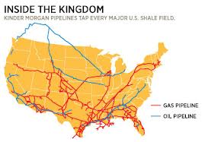
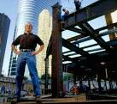
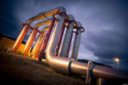
Core business:
From gas reserve underground to surface, across the land and to power stations (heat converted to electricity)

Slide 47
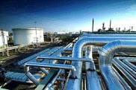
A natural resource
The economics
should be easy
1.Drill a well
2. Extract gas
3. Transport
4. Market
The buyers were state electricity administrators
A good market of supply and demand needed
“Perfect” knowledge. Transparency.
Honest government

Slide 48
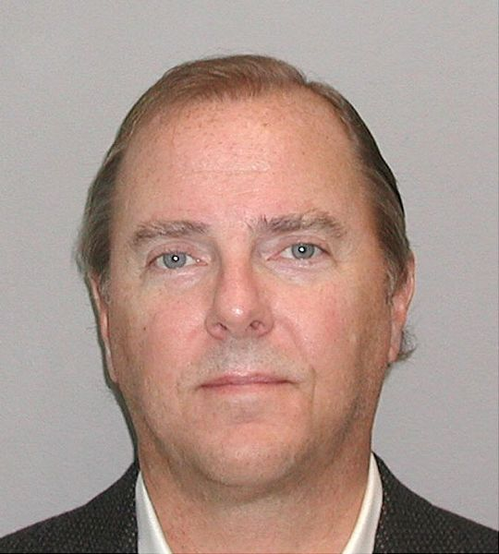
Jeffrey Skilling’s Worldview
The Selfish Gene by Richard Dawkins
was Skilling's favorite book and served
as the foundation of his managerial philosophy. Skilling held, by Skilling's interpretation, a Darwinian view of what makes the world work. He believed that money and fear were the only things that motivated people. He set up the performance review system (PRC) in which employees were graded from 1 to 5. Ten percent of people had to be a five, regardless of absolute performance; those 10% were to be fired.

Slide 49
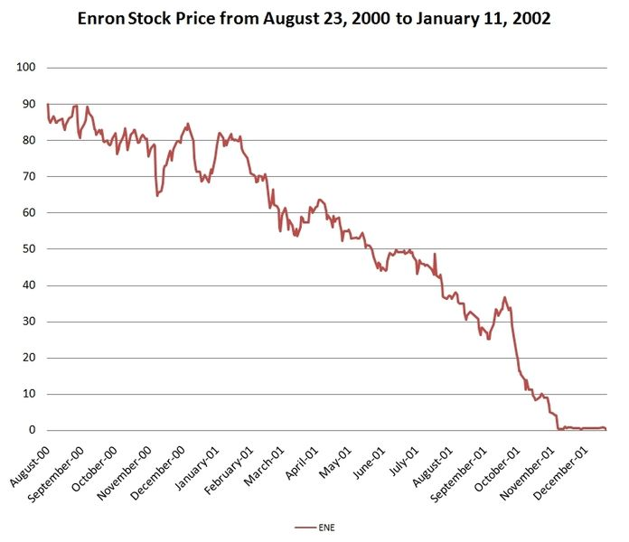
.[
Enron's stock price from August 23, 2000 ($90) to January 11, 2002 ($0.12). As a result of the decrease of the stock price, shareholders lost nearly $11 billion

Slide 50
The columnist Paul Krugman, writing in The New York Times, 2001.7.18,asserted that Enron was an illustration of the consequences that occur from the deregulation and commodification of things such as energy.
The broader goal of [Krugman's] latest attack on Enron appears to be to discredit the free-market system, a system that entrusts people to make choices and enjoy the fruits of their labor, skill, intellect and heart.
Kenneth Lay, CEO, Enron 2001.7,21

Slide 52
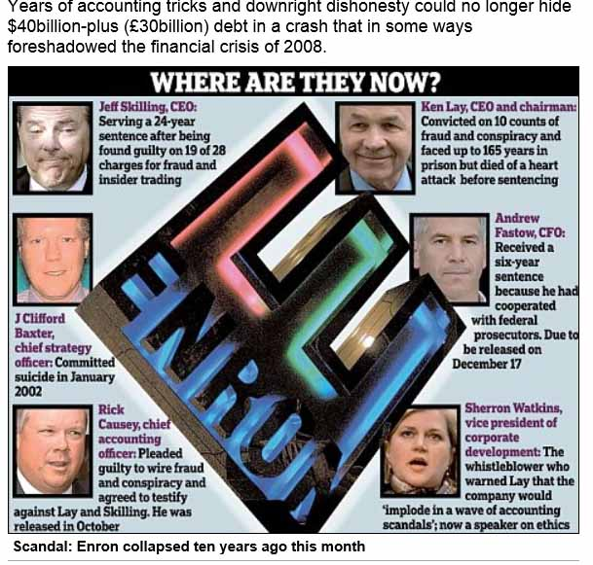
2011
report

Slide 53
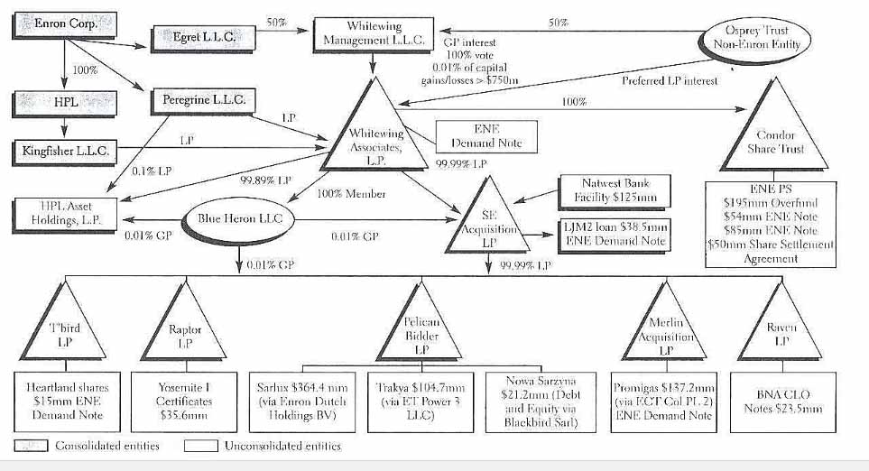
The Enron web of cheating lies

Slide 54
During his admissions interview for Harvard Business School, he stated that he was asked if he was smart, to which he supposedly replied, "I'm fucking smart".^{[11]}
Skilling earned his M.B.A. from Harvard Business School during 1979, graduating in the top 5% of his class as a Baker Scholar.
11 Bethany McLean and Peter Elkind , Smartest Guys in the Room: The Amazing Rise and Scandalous Fall of Enron, 2003, ISBN 1-59184-008-2.

Slide 55
During his admissions interview for Harvard Business School, he stated that he was asked if he was smart, to which he supposedly replied, "I'm fucking smart".^{[11]}
Self confidence?????
Skilling earned his M.B.A. from Harvard Business School during 1979, graduating in the top 5% of his class as a Baker Scholar.
11 Bethany McLean and Peter Elkind , Smartest Guys in the Room: The Amazing Rise and Scandalous Fall of Enron, 2003, ISBN 1-59184-008-2.

Slide 56
The best way to predict the future is to create it.”
– Peter Drucker

Slide 57
“I haven’t failed. I’ve found 10,000 ways that don’t work.”
-Thomas Edison

Slide 58
He exudes
self-confidence
他散发出的自信

Slide 59
Self confidence
Requires
Knowing the language
Telling people what to do

Slide 60
Put a cup on the table
Stand a cup on the table
Lie a cup on the table
Stand a cup on the table upside down

Slide 61
Stand a cup on the table right way up
Stand 2 cups on the table side by side
Stand a second cup on top of the first cup

Slide 62
Lie a cup on an angle in the mouth of the top cup.

Slide 63
Stand a cup vertically in the mouth of the cup that is on an angle

Slide 64
Tear up a hundred yuan note and put half in each cup

Slide 65
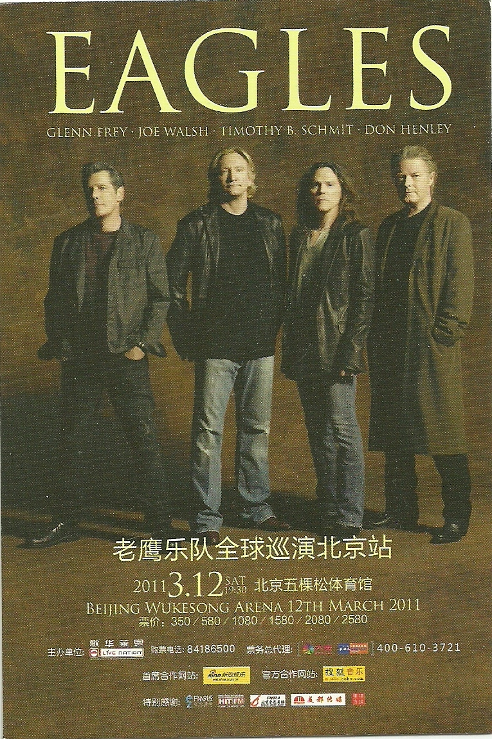
.

Slide 66
On a dark desert highway
Cool wind in my hair
Warm smell of Colitas rising
up through the air
Up ahead in the distance
I saw a shimmering light
My head grew heavy and
my sight grew dim
I had to stop for the night

Slide 67
There she stood in the doorway
I heard the mission bell
And I was thinking to myself
'This could be heaven or
this could be hell'

Slide 68
Then she lit up a candle
And she showed me the way
There were voices down the corridor
I thought I heard them say---

Slide 69
So I called up the Captain
'Please bring me my wine'
He said, 'We haven't had that spirit(注)
here
since nineteen sixty nine‘
于是我请领班过来
"帮我端酒来"
他说“我们这儿从1969年起就
不再供应烈酒了"

Slide 70
Wine 葡萄酒
Spirit 烈酒
Spirit 精神
You look in good spirits today

Slide 71
Wine 葡萄酒
Spirit 烈酒
Spirit 精神 National Spirit

Slide 72
Man on the moon, Color TV 1969 Cadillac
Watergate, Vietnam, oil crises, Elvis on drugs, racism, hippies. Monroe as Kennedys lover?
National spirit
Many indicators in commerce and social activity – movies (Doris Day), tourism (Disneyland)
High
Low
Rock Hudson as male hero
American technology (Atomic bomb) won
Military production turns to cars, white goods
Pearl Harbor, Japanese attack
Pres Kennedy says we have the technology to land a man on the moon this decade.
1942 1945 fifties 1962 1969 1976

Slide 73
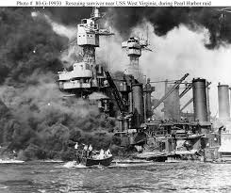
Attack on Pearl Harbor

Slide 74
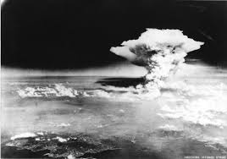

Slide 75
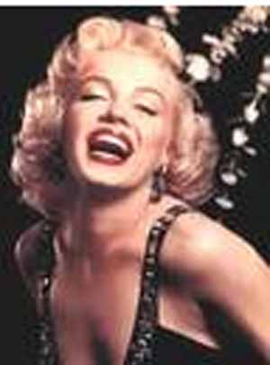
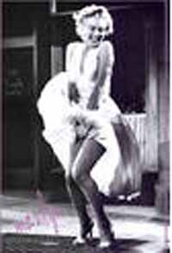
Marilyn Monroe 玛丽莲·梦露

Slide 76
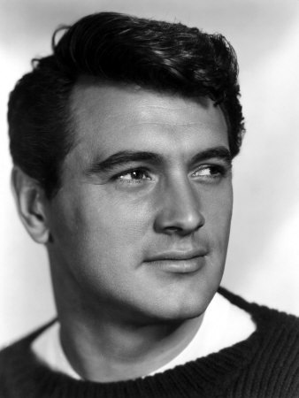
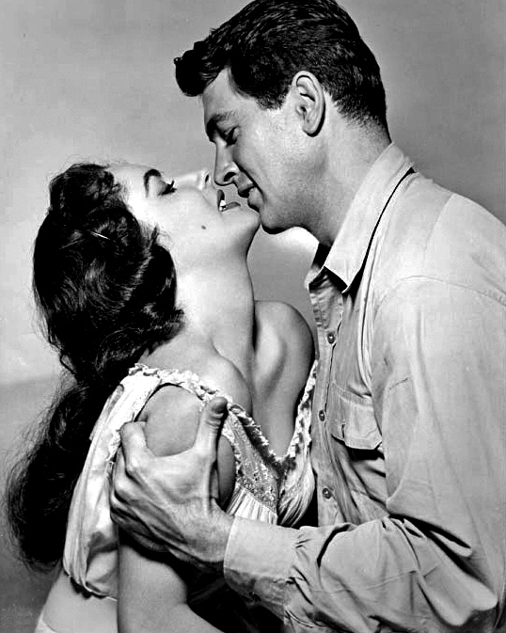
Rock Hudson 洛克·哈德森
with Elizabeth Taylor

Slide 77
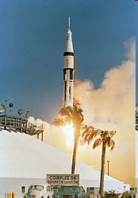
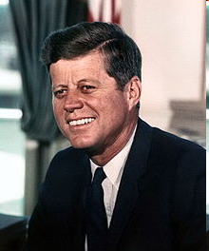
President Kennedy JFK

Slide 78
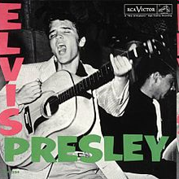
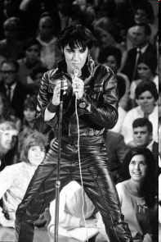
Elvis Presley 埃尔维斯·普雷斯利 猫王

Slide 79
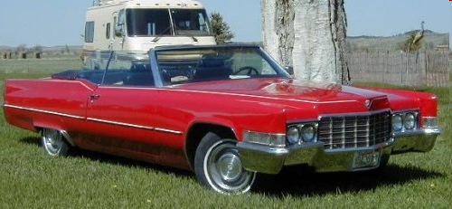
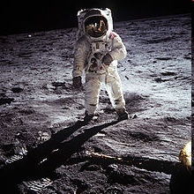
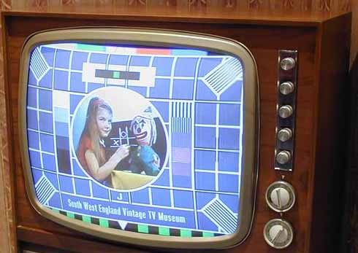
1969 “Golden Year”
Cadillac

Slide 80
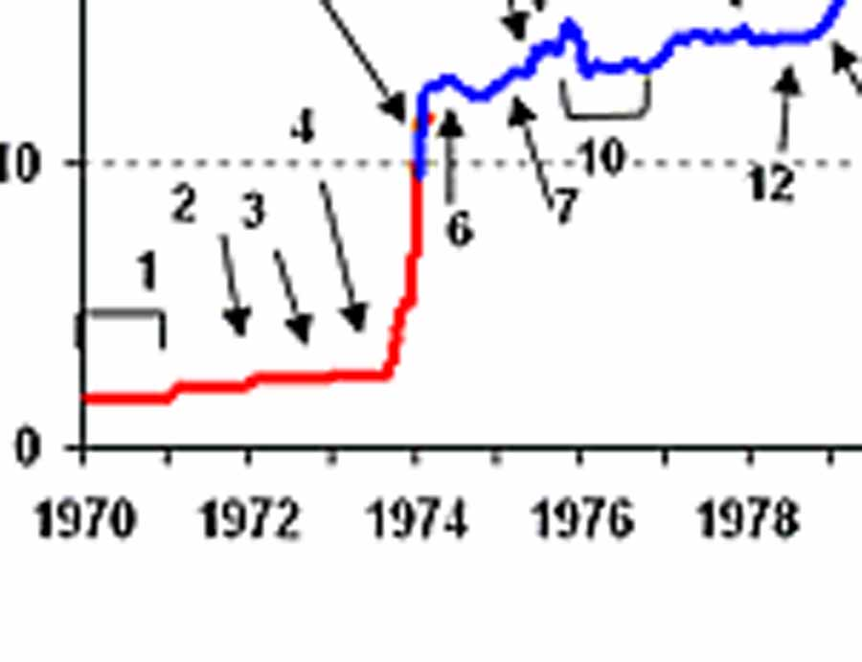
1973 OILCRISIS
Y
Oil $/barrel

Slide 81
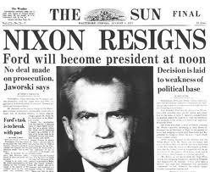
Y
理查德·
尼克松

Slide 82
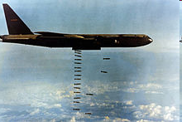
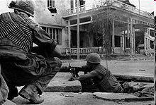
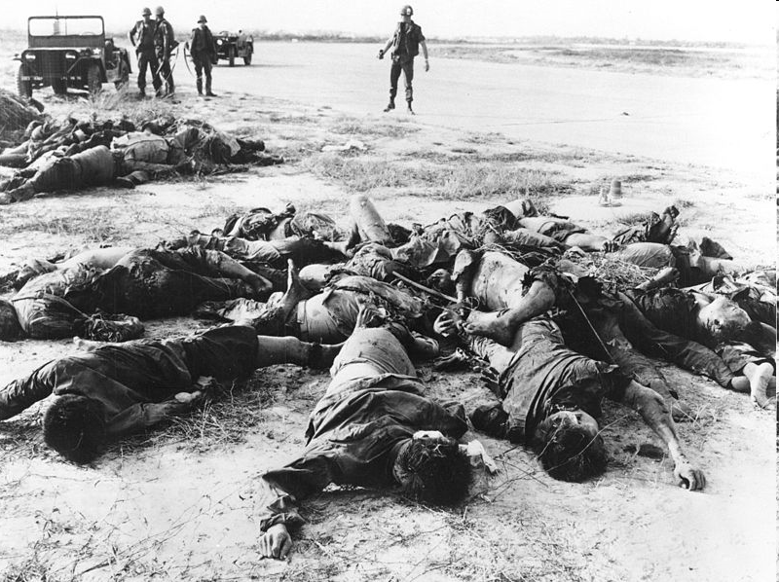
American Military Power

Slide 83
American Military Power

Slide 84
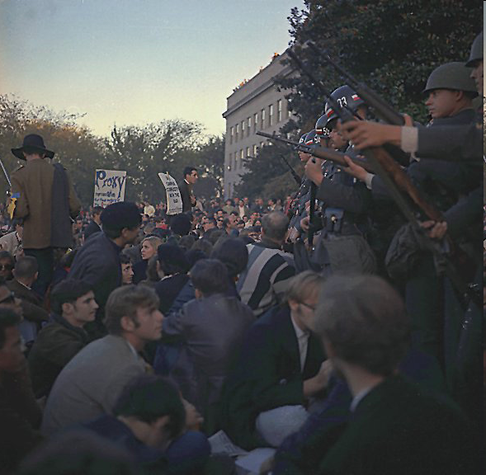
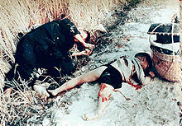
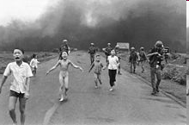
Mailai Massacre, Napalm Bombing, Vietnam War Protest

Slide 85
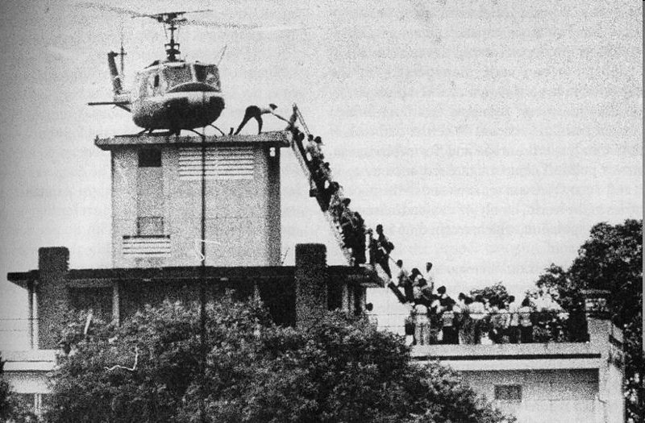
Fleeing Vietnam

Slide 86
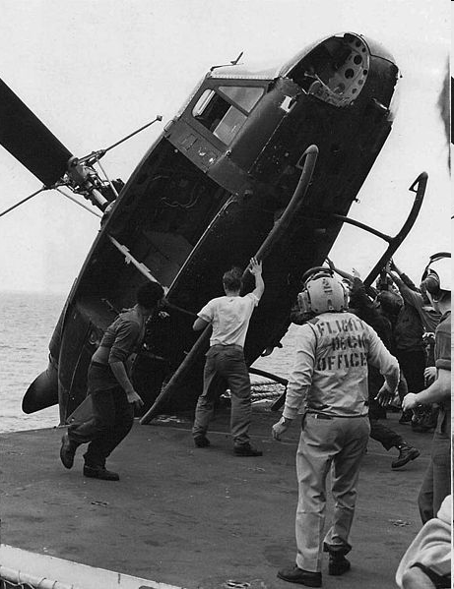
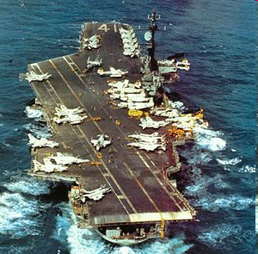
Embarrassing

Slide 87
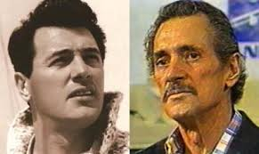
Hollywood icon Rock Hudson dies of AIDS

Slide 88
Man on the moon, Color TV 1969 Cadillac
Watergate, Vietnam, oil crises, Elvis on drugs, racism, hippies. Monroe as Kennedys lover?
National spirit
Many indicators in commerce and social activity – movies (Doris Day), tourism (Disneyland)
High
Low
Rock Hudson as male hero
American technology (Atomic bomb) won
Military production turns to cars, white goods
Pearl Harbor, Japanese attack
Pres Kennedy says we have the technology to land a man on the moon this decade.
1942 1945 fifties 1962 1969 1976

Slide 90
Enron
Financial
Crisis
2010 2014

Slide 91
Enron
Financial
Crisis
Back to basics
2010 2014

Slide 92
Enron
Financial
Crisis
Back to basics
2010 2014

Slide 93
Back to basics, hunting, barter
Or from 2014, measure good and services scientifically

